Slide 1

Football Attendance - Influences, Benefits and Consequences
Kiran Johnson – Capstone

Slide 2
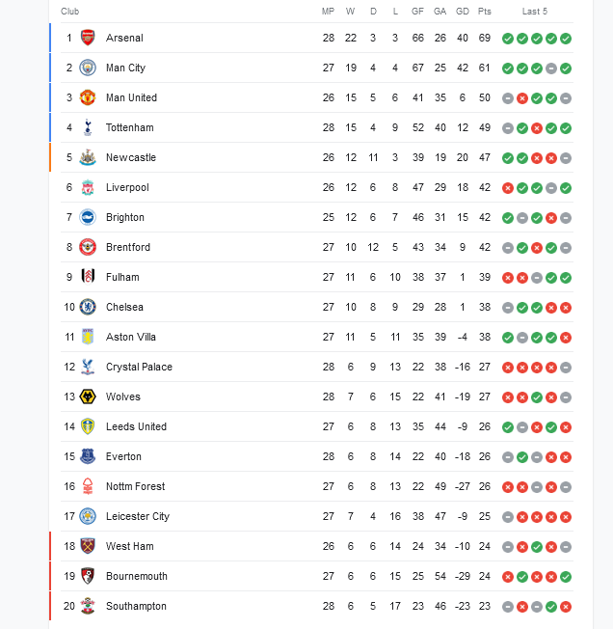


Premier League 2022/23 Standings/Inspiration for Project
MP = Matches Played
W = Wins
D = Draws
L = Loss
GF = Goals Against
GA = Goals Against
Pts = Points
Average it takes to get relegated since 2008?
MP = 28 MP = 27 MP = 26
W = 7 W = 6 W = 6
D = 6 D = 6 D = 6
L = 15 L = 15 L = 14
GA = 50 GA = 48 GA = 46
GD = -22 GD = -22 GD = -20
Pts = 26 Pts = 25 Pts = 24

Slide 3
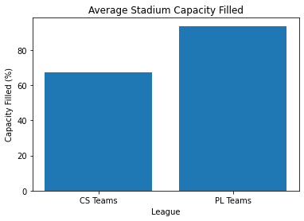
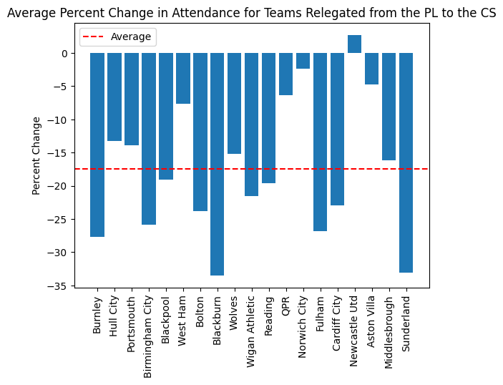
RELEGATION
Visually notice more empty stadiums in championship
Will this impact relegated teams?
Graphs created by comparing premier league and championship average attendances since 2009. Data from ‘Fbref.com’

Slide 4
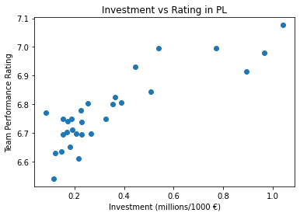
WHAT DOES THIS MEAN?
Ticket revenue accounts for approximately 20% of total revenue in the championship and Premier League. (source: https://www2.deloitte.com/uk/en/pages/sports-business-group/articles/annual-review-of-football-finance.html)
- Average of an 18% decrease in ticket revenue getting relegated
- Might effect some teams more (e.g. Blackburn saw a 30% decrease)
Deloitte Annual review of football reveals that ticket sales in English league one (third division of English football) account for 30% of all revenue.
-Relegation from the championship even more drastic!!
Less revenue = Less Investment = Worse Performance
Merged graph with team performance rating from ‘whoscored.com’ and investment from ‘transfermaket.com (since 2013)’

Slide 5
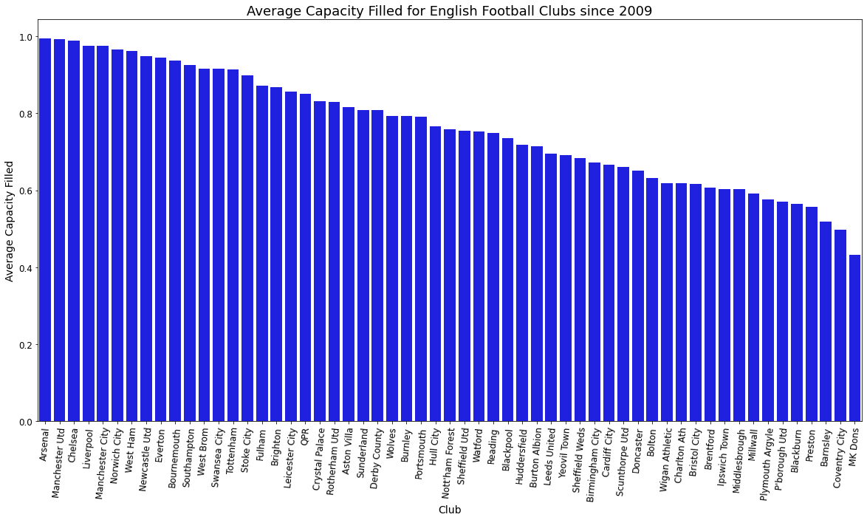
Fortresses to Libraries
More empty seats = less tickets sold = less revenue
Power of the fans? Moderate positive Correlation (0.32) between Capacity Filled and performance
Capacity filled = (average attendance / Stadium capacity ) /100

Slide 6
How to increase attendances?
Fan Engagement
- Atlanta United F.C. (MLS) - attendances averaged 48000 in 2017 and now 51000 in 2022 (Fbref.com) (https://smartseries.sportspromedia.com/features/mercedes-benz-stadium-fan-experience-ibm)
Pricing Strategies
-Bundesliga 2018 reduced ticket prices- saw a 5.2% increase in attendance (Fbref.com) (https://www.sportspromedia.com/news/bundesliga-ticket-prices/
Community Outreach
- Luton Town football camps ->>>> free tickets to kids. Or ‘Family for a Fiver’. Avg attendance increased from approx 5,500 to 10,000 from 2014-2019 (Fbref.com)
- Leyton Orient Fc reduced adult tickets and implemented strategies such as “kids for a quid” or giving free ticket to kids in football camps. Attendance increased from approx. 4400 in 18/19 to 5500 in 19/20 (Fbref.com)
- Bradford A.F.C reduced season ticket pricing in 2015 resulting in a 20% increase in season ticket sales a 4% increase in attendance (Fbref.com) (https://www.telegraph.co.uk/sport/football/teams/bradford-city/11647058/Bradford-City-announce-season-ticket-price-r eduction-to-attract-more-fans.html)

Slide 7
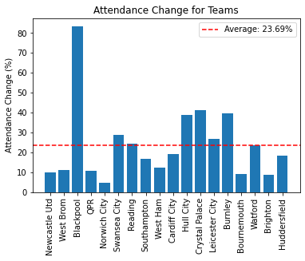
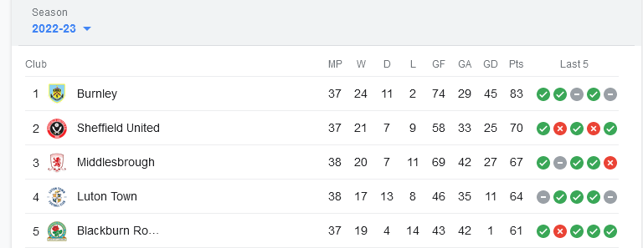
PROMOTION
Average it takes to get promoted at this point in the season (since 2008)
MP = 37/46
W = 21
D = 9
L = 7
GA = 36
GD = 26
Pts = 71
Attendance will almost certainly increase
Average of 23.69% increase
Ticket Revenue increase

Slide 8
WHAT DOES THIS MEAN?
Consider stadium capacity
- need to accommodate increased fans; After Leicester League win in 2016 they increased stadium capacity to 42,000 (Fbref.com)
Increase ticket prices but not for loyal fans
- Brighton 2017 implemented a priority system for season ticket holders. (https://www.theargus.co.uk/sport/15622415.brighton-and-hove-albion-ticket-priority-system-proving-a- success/)
Merchandise and Food services
- Tottenham 2019 new stadium experienced food and drink shortages as they were unprepared for the increase in stadium attendances (https://www.telegraph.co.uk/football/2019/04/04/tottenham-apologise-fans-long-queues-food-shortages-new-stadium/)
Security
- West Ham 2016 underprepared security measures due to increase fan attendance after moving into the Olympic stadium. Poor crowd control led to more violence resulting in a fine. (https://www.theguardian.com/football/blog/2016/oct/27/six-areas-of-contention-west-ham-united-london-stadium)

Slide 9
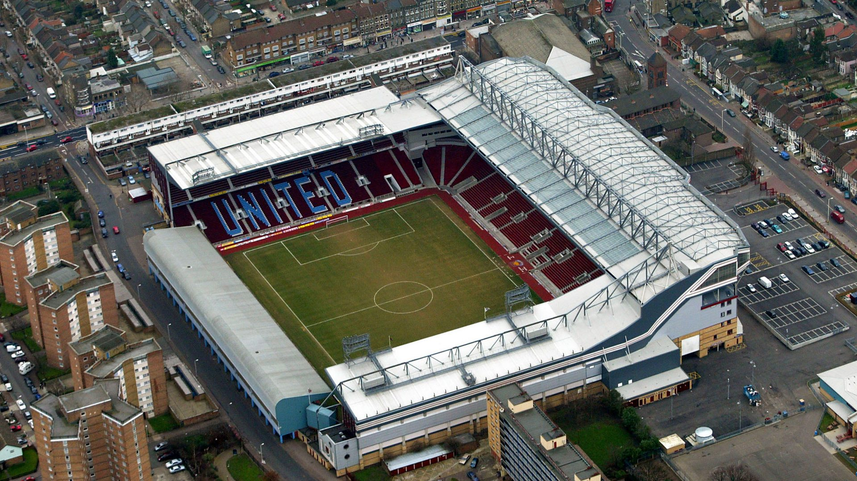
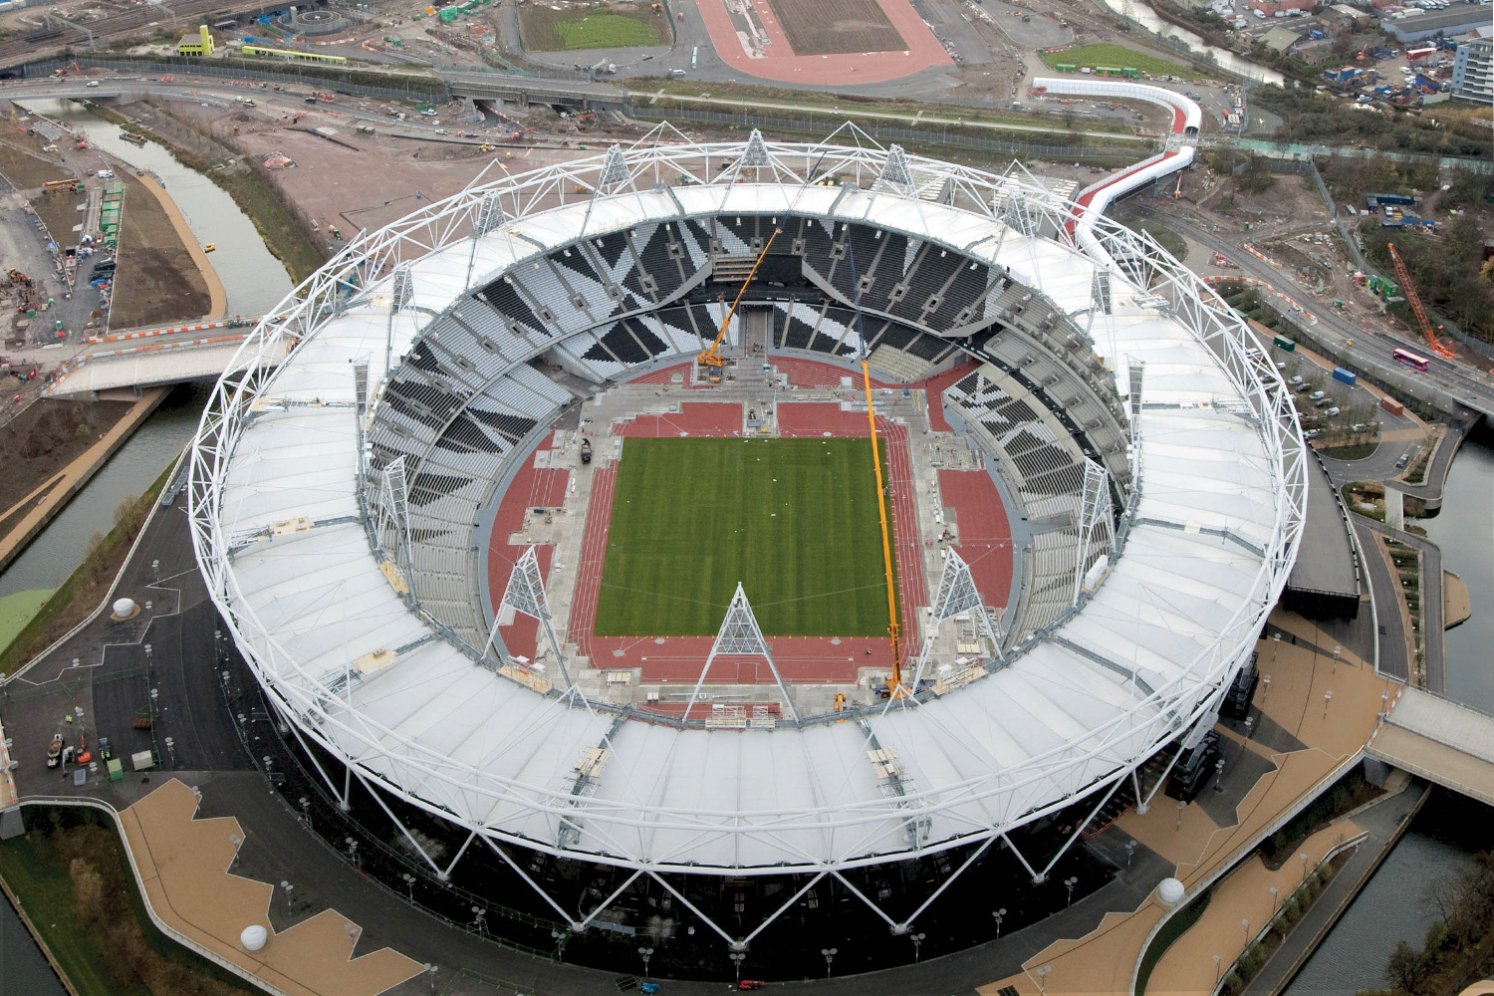
DATA COLLECTION EVALUTATION & LIMITATIONS
Stadium Capacities change
- Clubs move into new stadiums
- some clubs have very minor expansions
Different websites = different format
- ‘West Ham’ and ‘West Ham United’
Detailed performance metrics relatively new
- whoscored championship performance metrics only started in 13/14 season
Scraped and Merged Data from these sites:
http://ww1.transfermarket.com/?sub1=d9d040c2-ce44-11ed-af42-0eccb3962b35 – Club expenditure
https://www.whoscored.com/ - Performance analysis
https://fbref.com/en/ - Football Club attendances and League tables

Slide 10
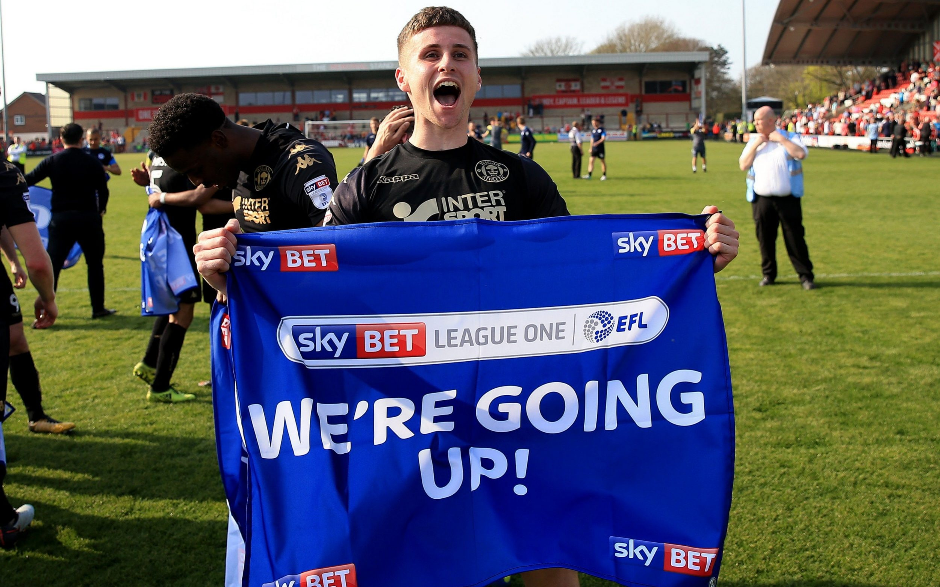
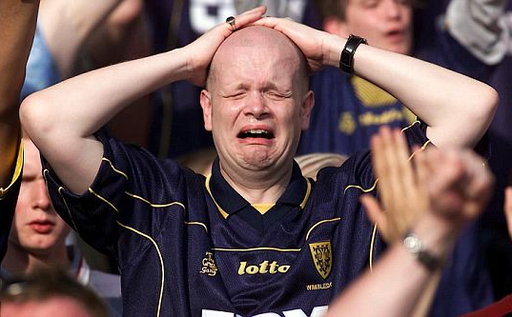
CLOSING THOUGHTS & QUESTIONS

